Slide 1
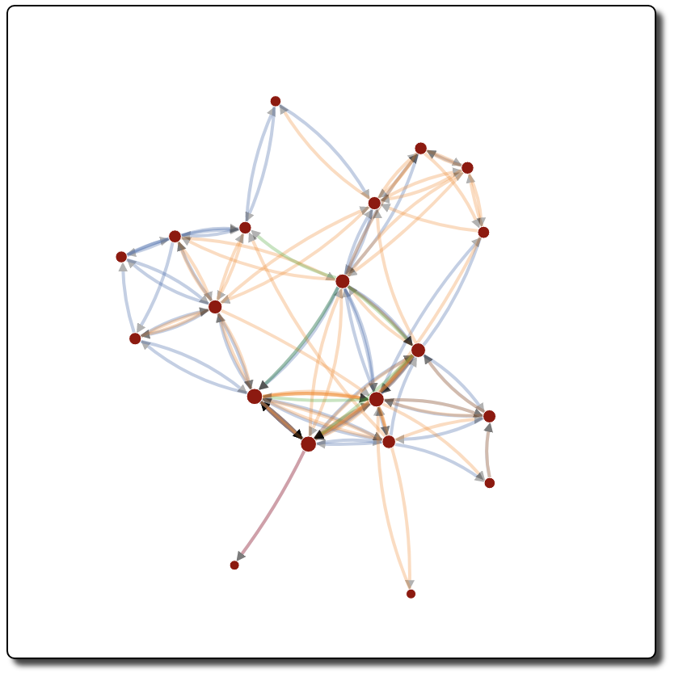
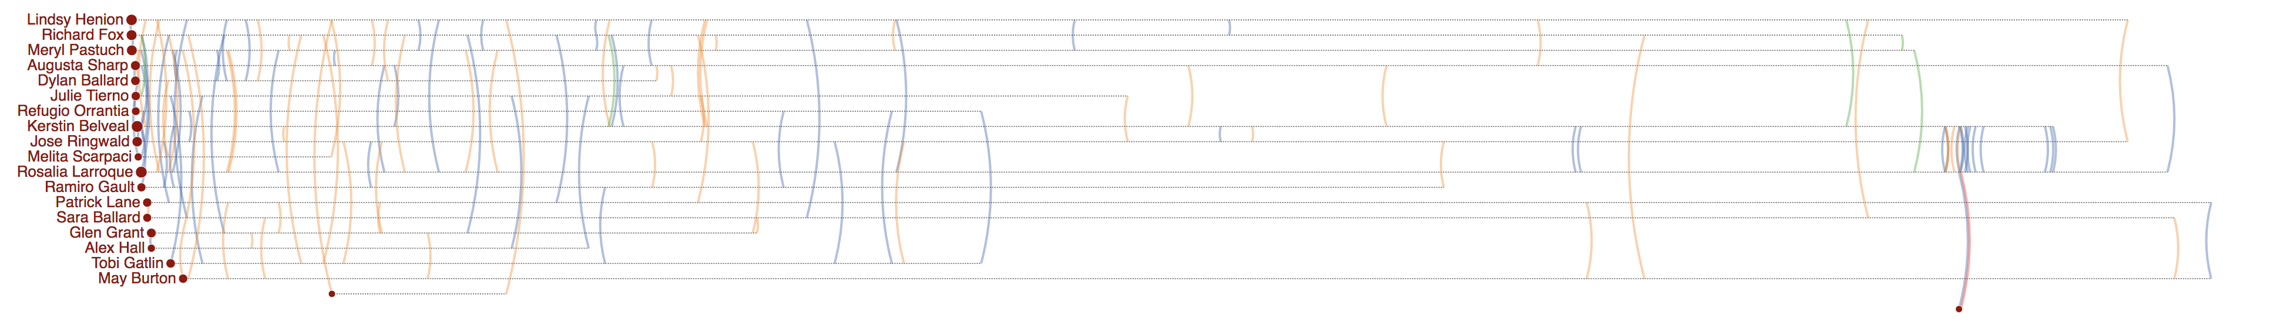
Rosalia Larroque
Rosalia Larroque
Jenice Savaria
Jenice Savaria

Slide 2
Rosalia Larroque
Rosalia Larroque
Jenice Savaria
Jenice Savaria

Slide 3
Rosalia Larroque
Rosalia Larroque
Jenice Savaria
Jenice Savaria

Slide 4
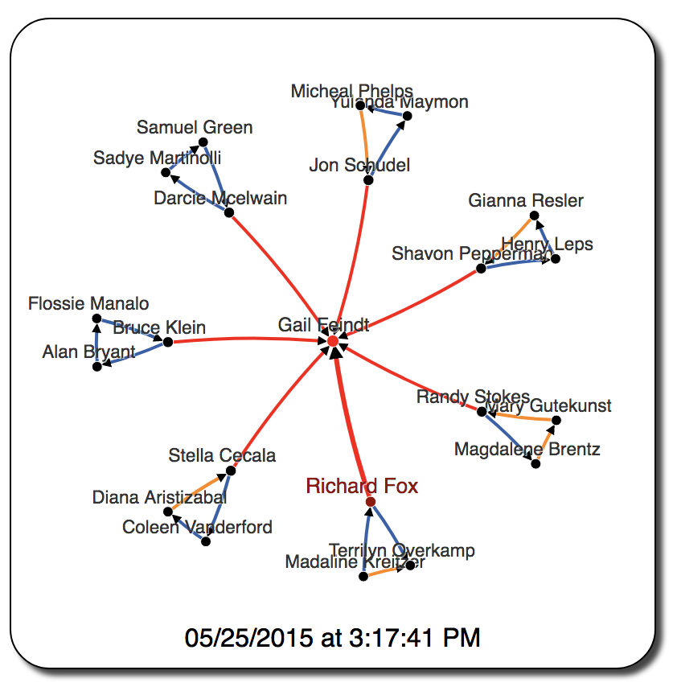
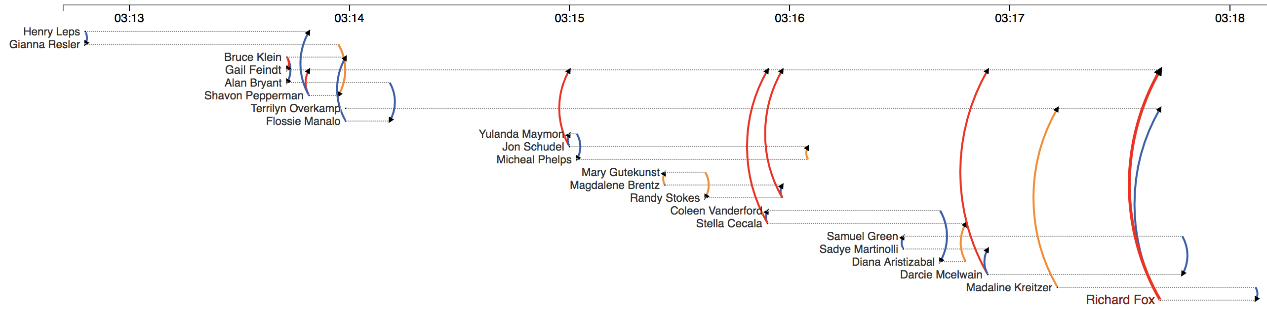

Slide 5
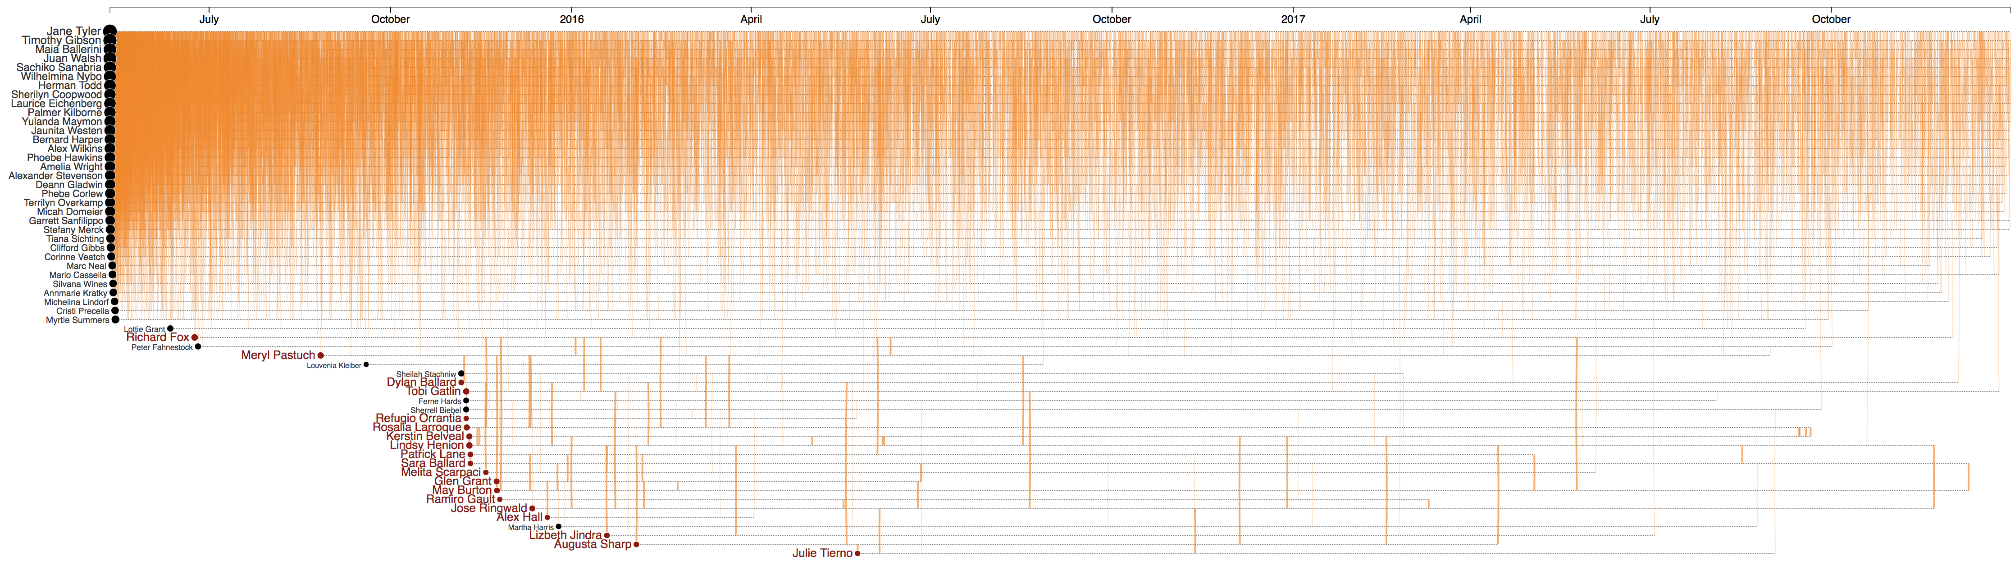
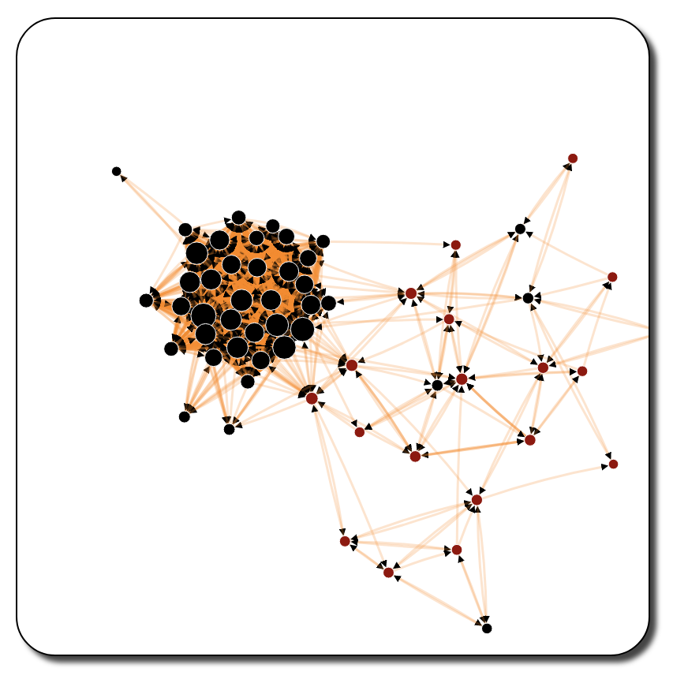
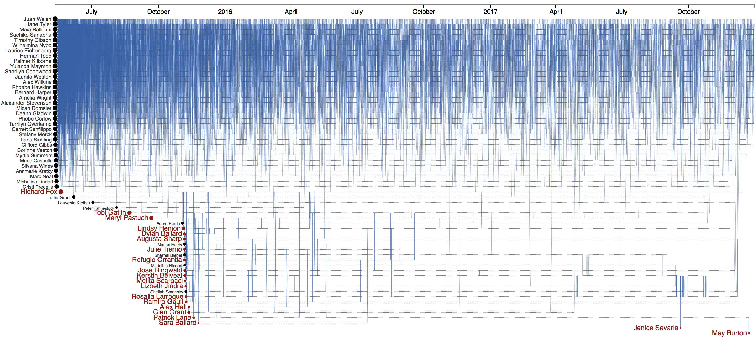
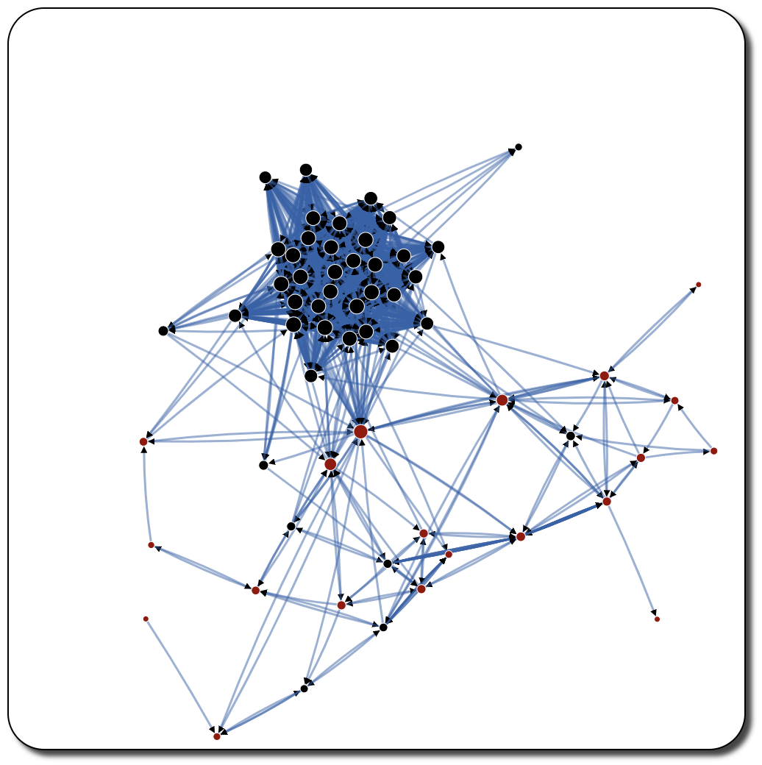

Slide 7
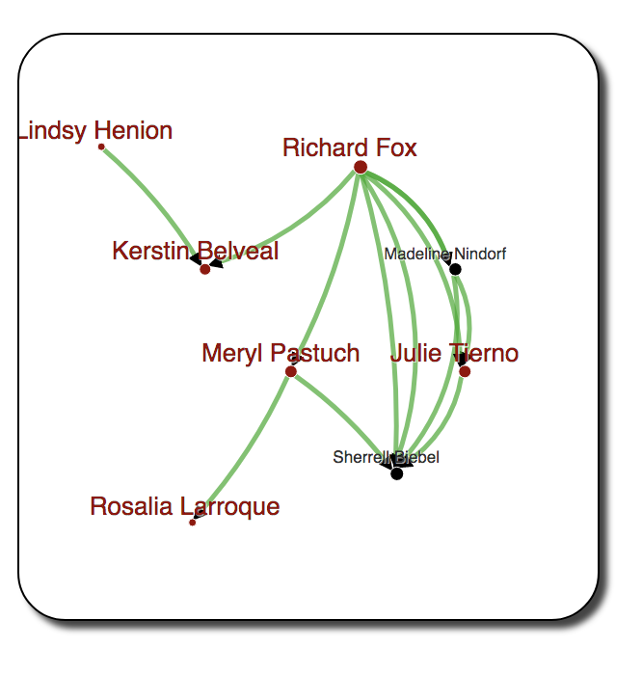
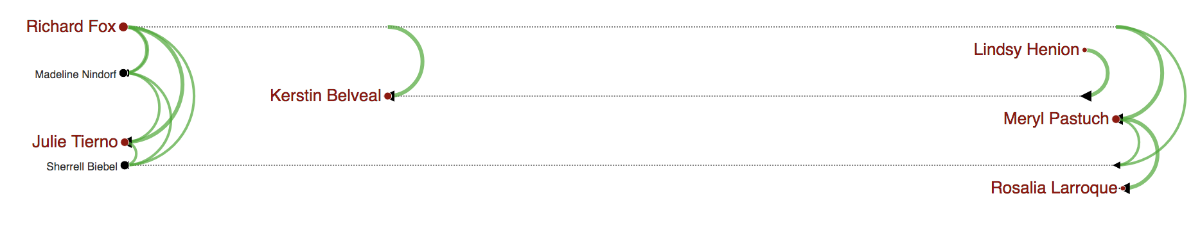
(a)
(b)
Gail Feindt

Slide 8
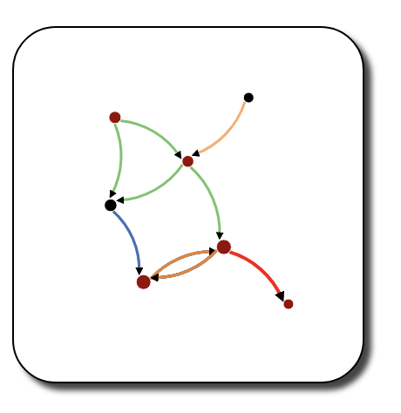
Richard Fox
Peter Fahnestock
Meryl Pastuch
Sherrell Biebel
Rosalia Larroque
Kerstin Belvea
Jenice Savaria
Jenice Savaria
(b)
(a)
Gail Feindt

Slide 9
Richard Fox
Peter Fahnestock
Meryl Pastuch
Sherrell Biebel
Rosalia Larroque
Kerstin Belvea
Jenice Savaria
Jenice Savaria

Slide 10
Richard Fox
Jenice Savaria

Slide 11
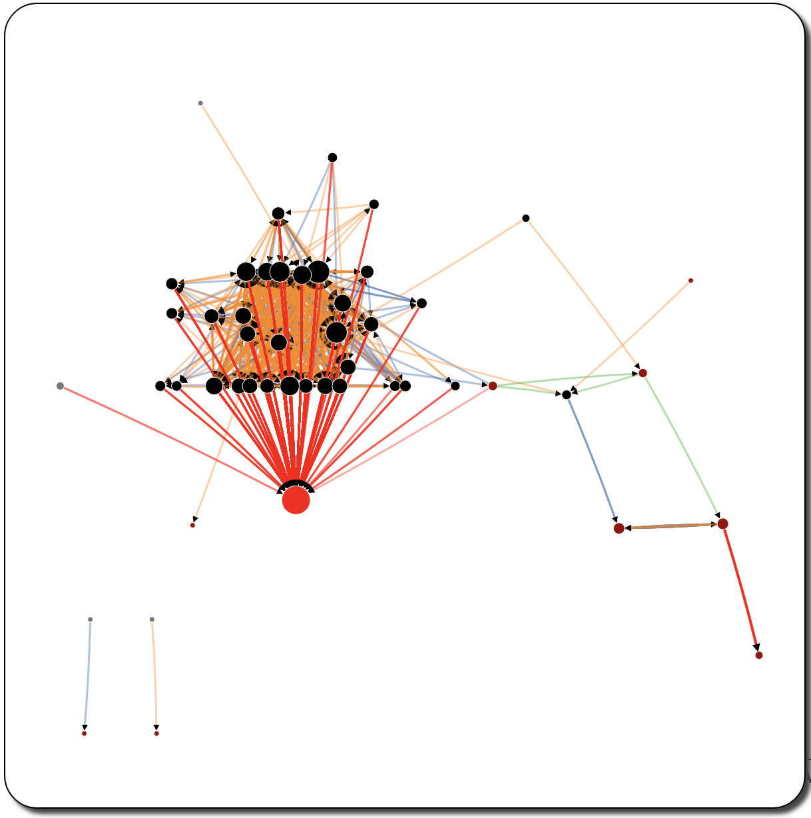
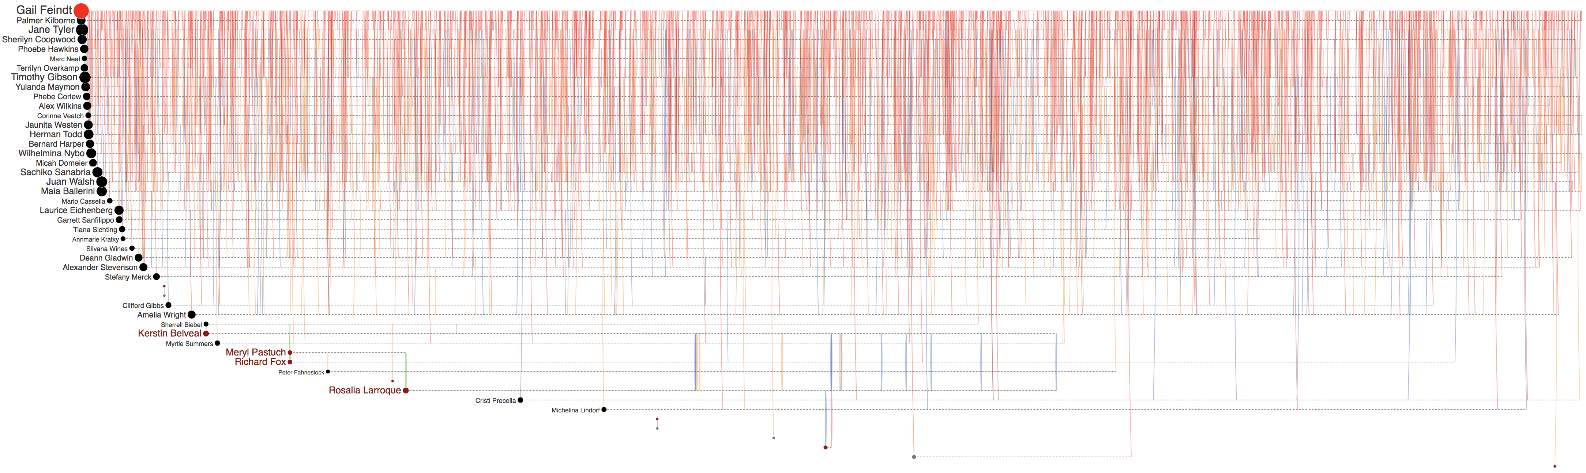
Peter Fahnestock
Meryl Pastuch
Richard Fox
Sherrell Biebel
Kerstin Belvea
Gail Feindt
Rosalia Larroque
Jenice Savaria
Rosalia Larroque
Jenice Savaria
Jenice Savaria

Slide 12
Richard Fox
Gail Feindt
Rosalia Larroque
Jenice Savaria
Rosalia Larroque
Jenice Savaria
Jenice Savaria

Slide 13
Peter Fahnestock
Meryl Pastuch
Richard Fox
Sherrell Biebel
Kerstin Belvea
Rosalia Larroque
Gail Feindt
Jenice Savaria
Jenice Savaria
Jenice Savaria

Slide 14
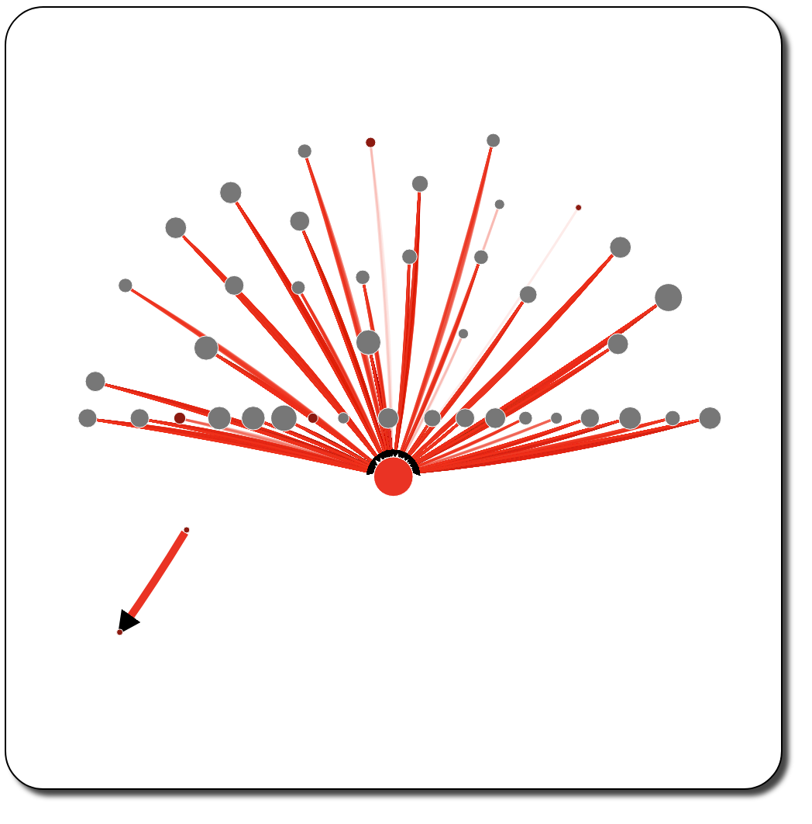
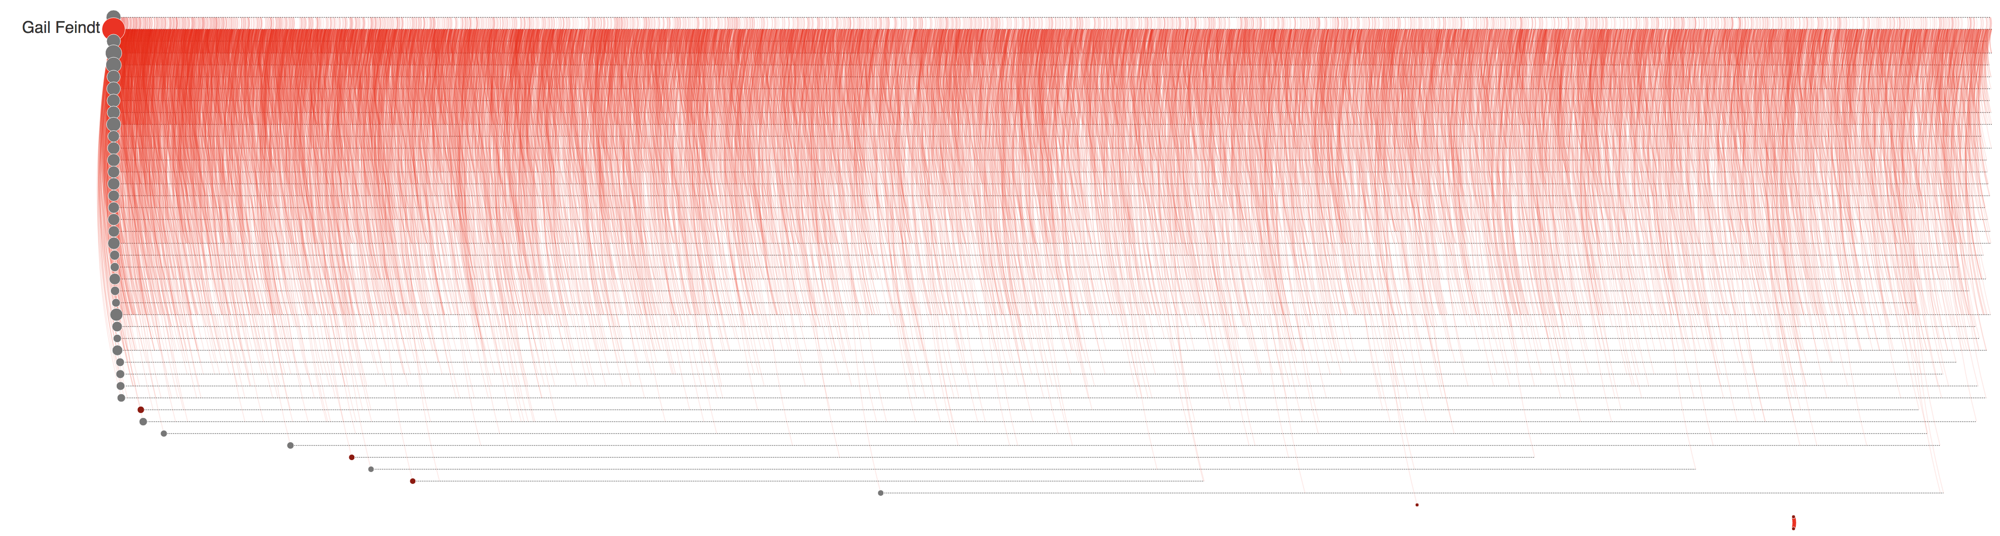


Rosalia Larroque
Jenice Savaria
(a)
(b)
Rosalia Larroque
Jenice Savaria

Slide 15
Gail Feindt
Rosalia Larroque
Jenice Savaria
Rosalia Larroque
Jenice Savaria

Slide 16
Gail Feindt
Rosalia Larroque
Rosalia Larroque
Jenice Savaria

Slide 18
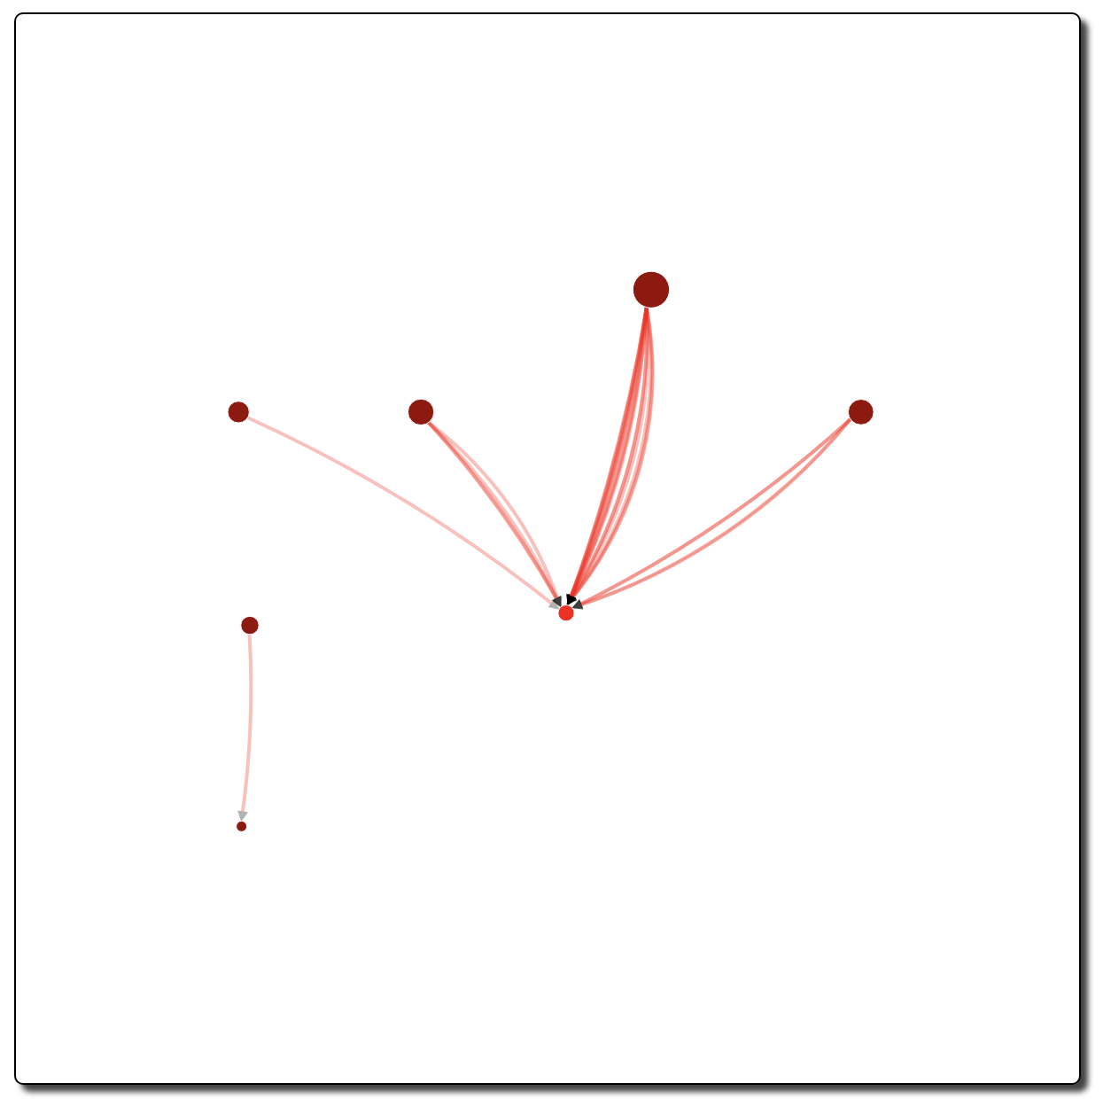
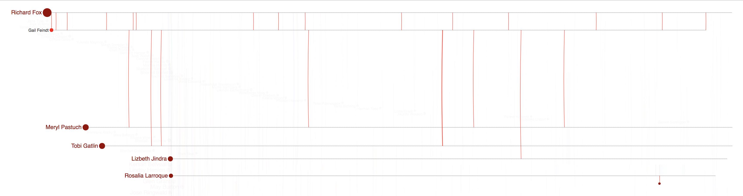
(a)
(b)

Slide 19
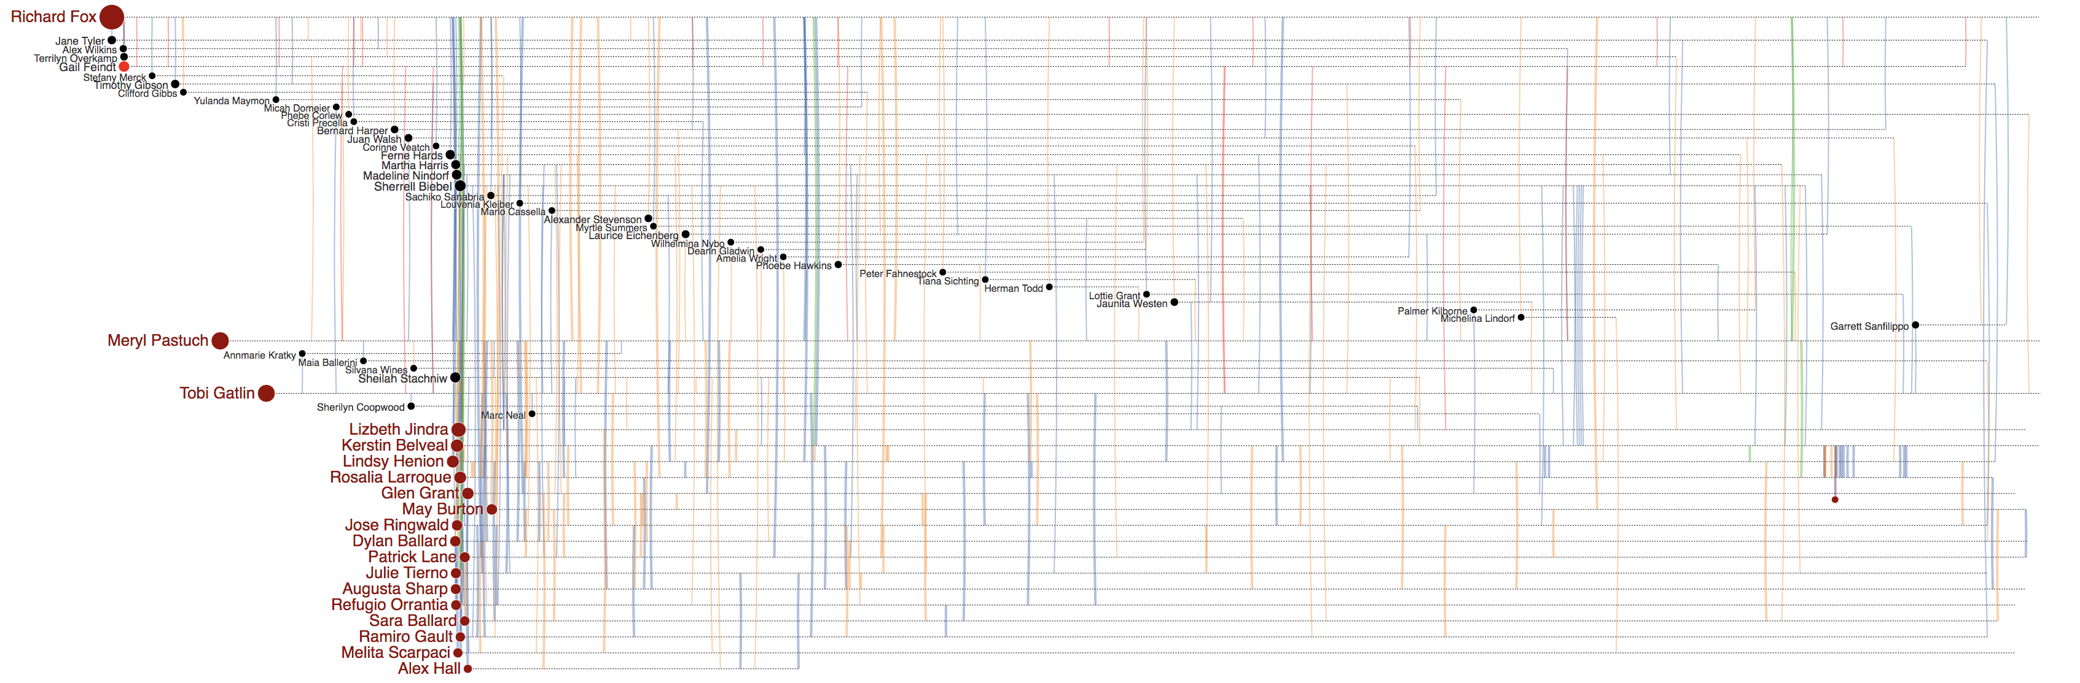
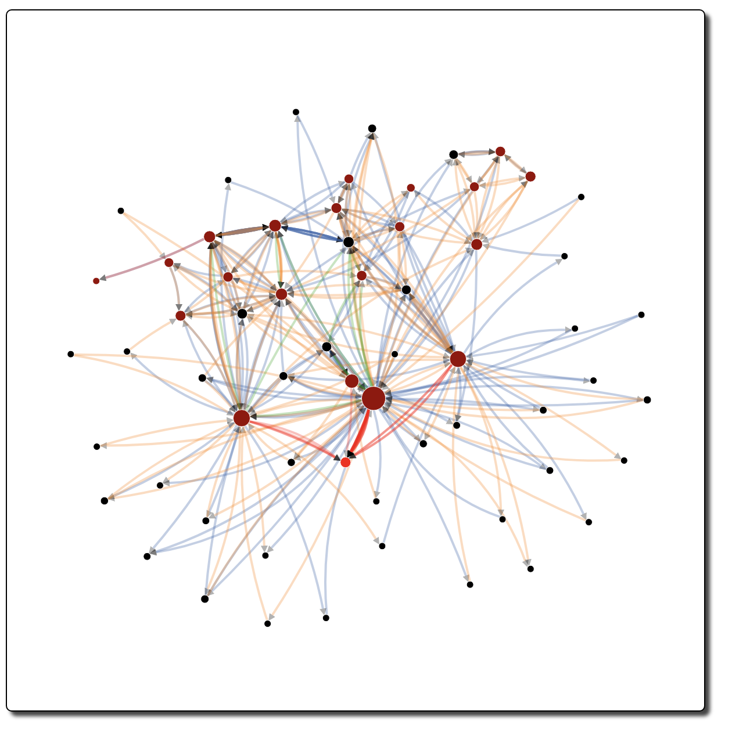
(a)
(b)

Slide 20
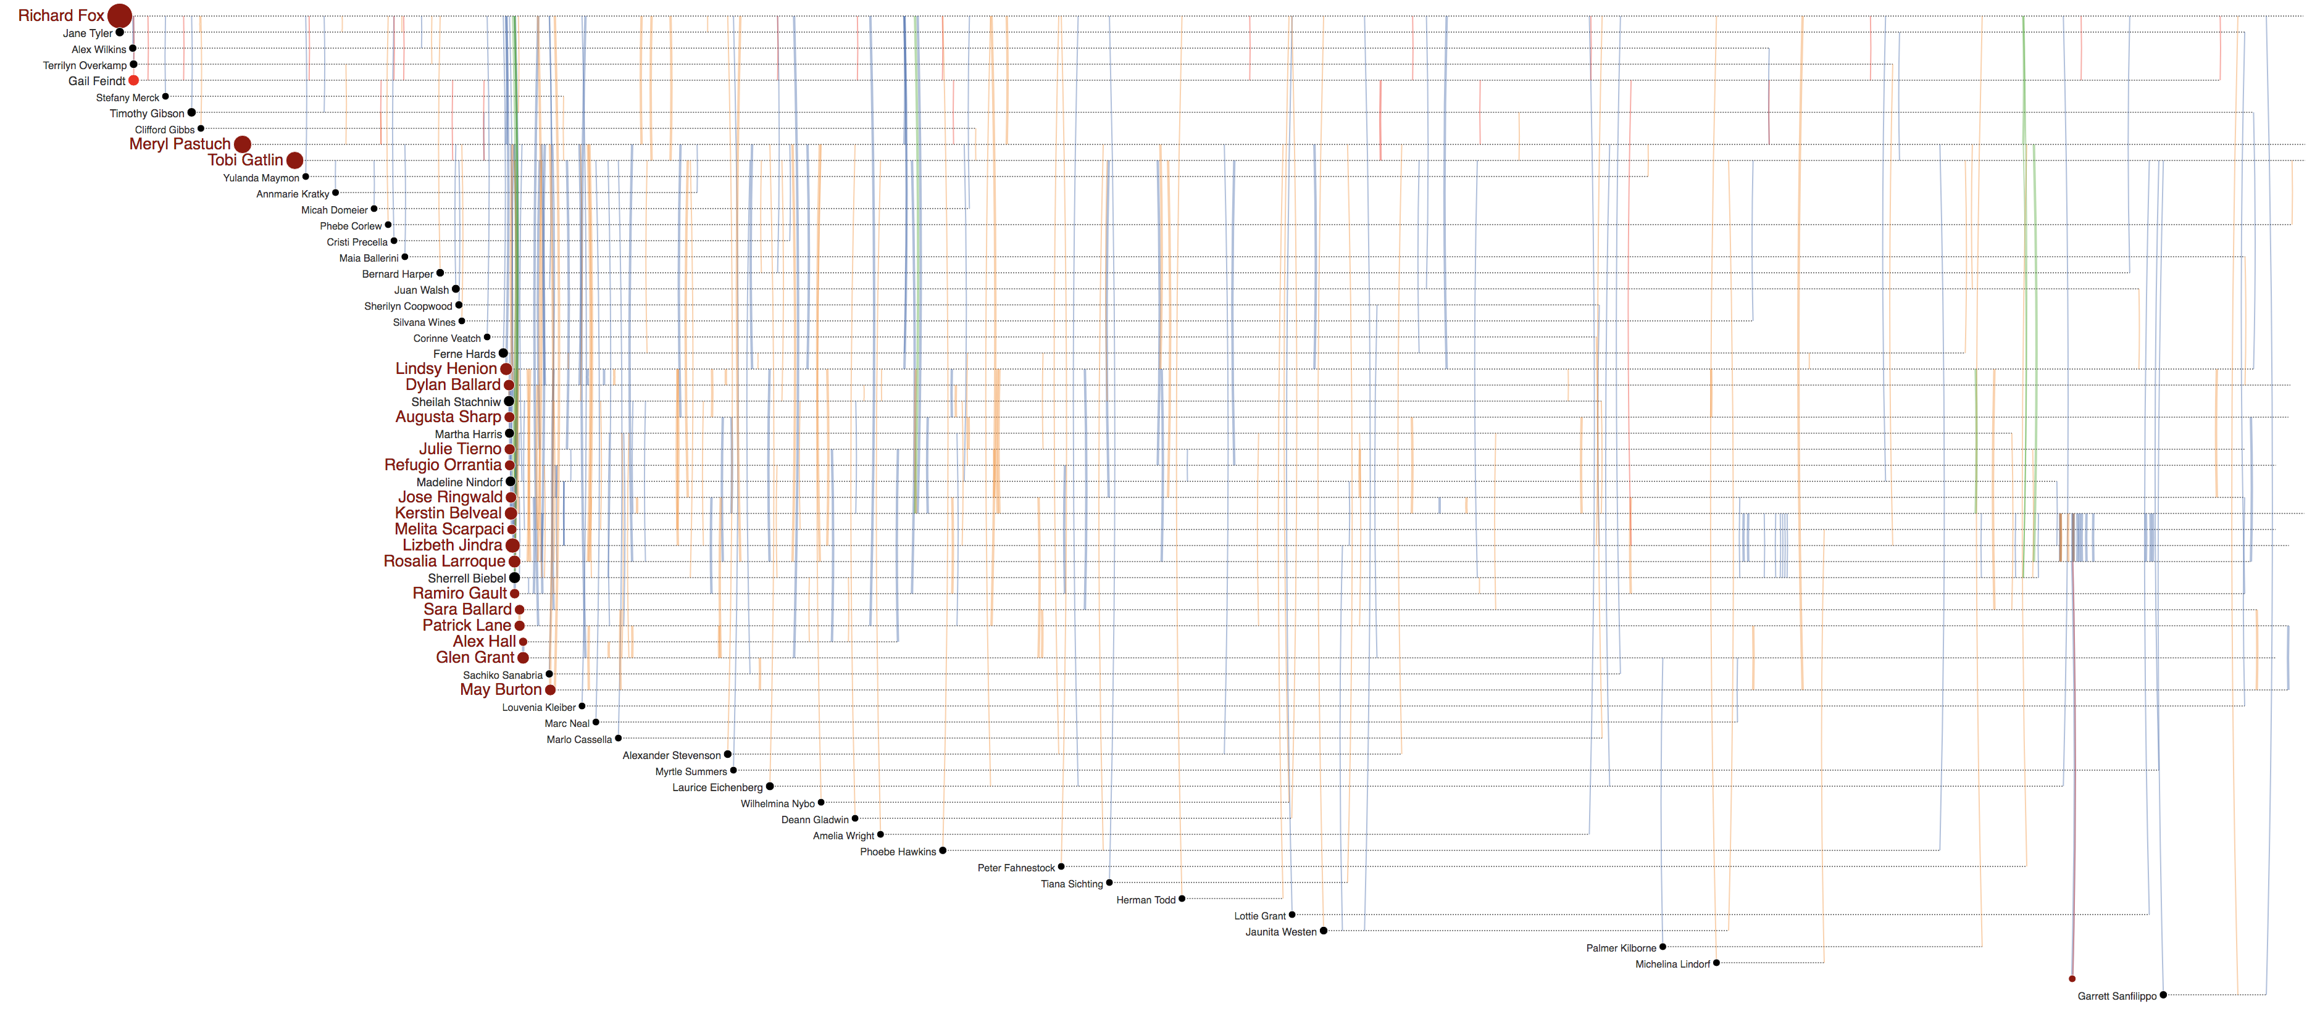
Jenice Savaria
Gail Feindt
(b)
Jenice Savaria
(a)
Jenice Savaria
(c)

Slide 21
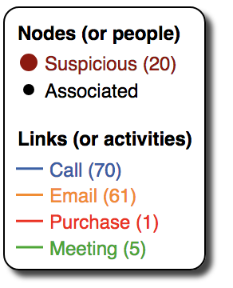
Rosalia Larroque
Jenice Savaria

Slide 22
Rosalia Larroque
Rosalia Larroque
Jenice Savaria
(b)
Jenice Savaria
(a)

